Slide 1
Disaster Tweet Classification
NLP & Machine Learning Portfolio Project
Python/Machine learning / Deep Learning
Ashwini Dmello
NLP
ML
AI

Slide 2
Executive Summary
Automated identification of disaster-related tweets for rapid
emergency response.
Identifying disaster-related tweets manually
Delayed emergency response
Information overload
Build a model that automatically classifies tweets as:
✅ Disaster
✅ Non-Disaster
NLP
ML
AI

Slide 3
Business Problem
Millions of tweets are generated daily. Manual monitoring is
impractical.
Data Collection ↓Model Training ↓Prediction ↓Evaluation
↓Data Cleaning
↓Tokenization
↓Lemmatization
↓TF-IDF
NLP
ML
AI

Slide 4
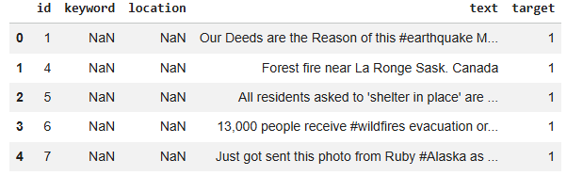
Solution Architecture
Tweets → Cleaning → TF-IDF → Naive Bayes → Prediction
NLP
ML
AI

Slide 5
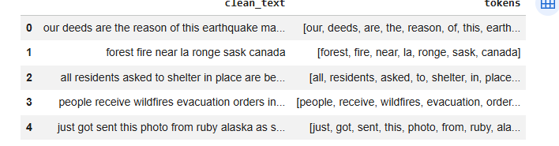
Dataset Overview
Twitter disaster dataset with text and binary target labels.
NLP
ML
AI

Slide 6
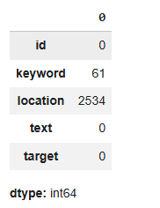
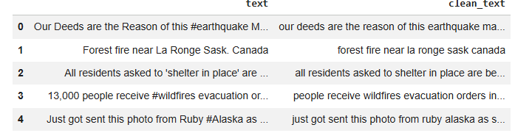
Data Preprocessing
URL removal, punctuation cleaning, lowercasing, tokenization, label encoding.
NLP
ML
AI

Slide 7
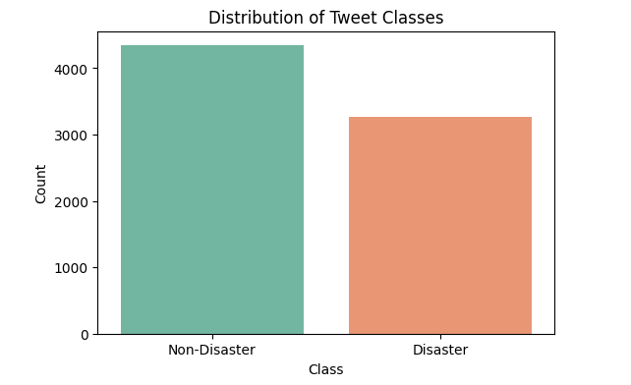
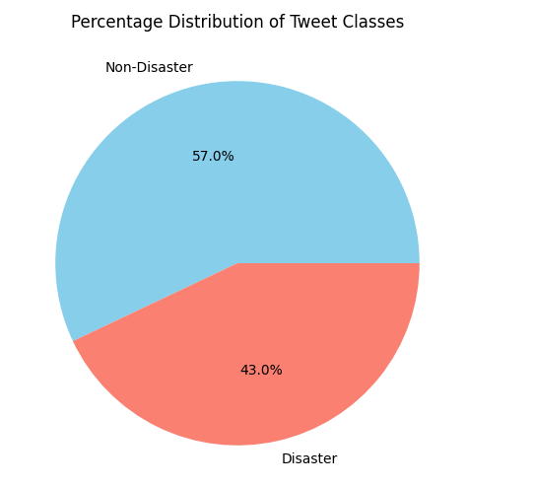
Exploratory Analysis
Class distribution and text pattern analysis.
NLP
ML
AI

Slide 8
Feature Engineering & Modeling
TF-IDF with 5000 features and Multinomial Naive Bayes.
✅ Fast Training
✅ Easy Implementation
✅ Good for NLP
✅ Works well with TF-IDF
✅ Suitable for Large Text Datasets
NLP
ML
AI

Slide 9
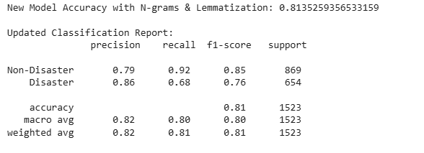
Model Evaluation
Confusion Matrix, ROC Curve, Precision Recall Curve, Classification Report.
NLP
ML
AI

Slide 10
Business Impact & Future Roadmap
Disaster intelligence, transformer models, real-time alerts.
Faster disaster tweet detection
Reduced manual monitoring
Improved emergency response
Real-time alert capability
NLP
ML
AI

